Slide 1
safetyGraphics 2021 R/Pharma Workshop
An open source framework for evaluation of clinical trial safety
Links: CRAN | GitHub | Demo
Workshop Logistics at: www.safetygraphics.org

Slide 2
Disclaimers
Sample data has been provided for all examples since we are using a cloud-based platform for the workshop. We recommend that you:
safetyGraphics is not Validated or Qualified. Consult with stakeholders at your organization (IT, Compliance, etc.) before using it in your work.
Please don’t use any private data during the workshop.
For more info about security and other technical topics see our FAQ

Slide 3
Workshop Objectives
Learn how to configure the safetyGraphics Shiny app.
Initialize the app with sample data
Load custom data
Provide a data mapping to simplify chart configuration
Export individual charts or the code to recreate the whole app
Customize default charts or add new ones
Add additional data domains

Slide 4
Agenda
0. Intro To safetyGraphics (20 min)
Hello World (10 min)
Breakout 1
Loading Custom Data (30 min)
Breakout 2
Chart/App Export (10 min)
-------------- Break ------------ (10 min)
4. Creating Custom Charts (1 hr)
Breakout 3 & 4
5. Creating Custom Data Domains (40 min)
6. Chat + Q&A (Also at safetyGraphics Booth during conference)
Beginner
Advanced

Slide 5
00. Intro To safetyGraphics
Quick Group Background and Technical Overview

Slide 6

Interactive Safety Graphics (ISG) Working Group
Sub-team of DIA & ASA-Biopharm Safety Working Group
https://safetygraphics.github.io/

Slide 7




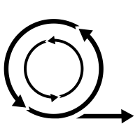


ISG Guiding Principles
Open Source
Highly Collaborative
Interactive
Easy to use
Data Standard Compliant
Agile
Engaging
Notes:
Open Source - Transparent. Customizable. Free!
Highly Collaborative - Clinicians and Programmers working together.
Interactive - Users can explore their data.
Easy to Use - Just open up a webpage.
Easy to Configure - Streamlined configuration with R.
Compliant with Data Standards - Support ADaM and SDTM by default.
Agile - Frequent releases with GitHub.
Engaging - Regular Feedback from users. Pilot testing. Open issue tracking.

Slide 8
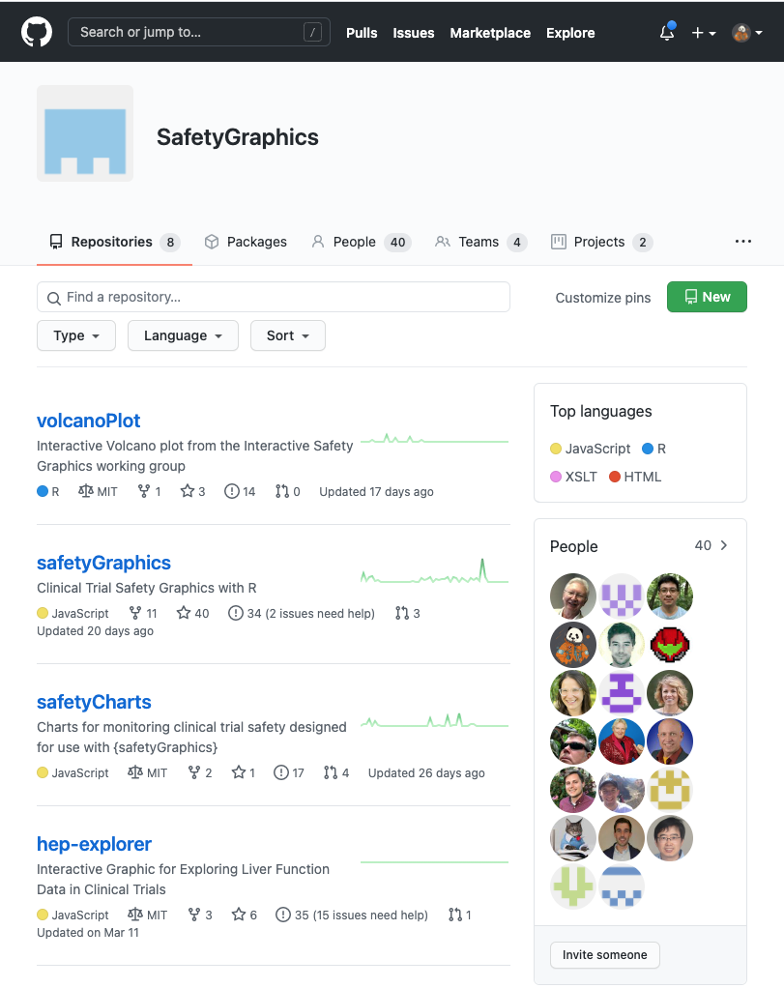
Open and Transparent Online Collaboration
We use a public GitHub site for:
Source Code Storage
Version Control
Testing/QC infrastructure
Issue tracking
Release Tracking
Discussion boards
Meeting Minutes
Project Management (Kanban boards, etc.)
Web-site hosting
Continuous Integration
https://github.com/SafetyGraphics

Slide 9
Want to get involved?
Sign up here!
(or send us an email)

Slide 10
Moving from Static to Interactive
Phase 0
2012-2018
Phase 1
2018-2019
Establishing an Open-Source Working group
Building a Robust Technical Framework
Phase 2
2019-2021
Interactive Safety Graphics WG
We are here
Phase 3
2021-???
Building Production Workflows

Slide 11
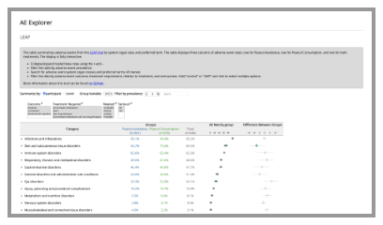
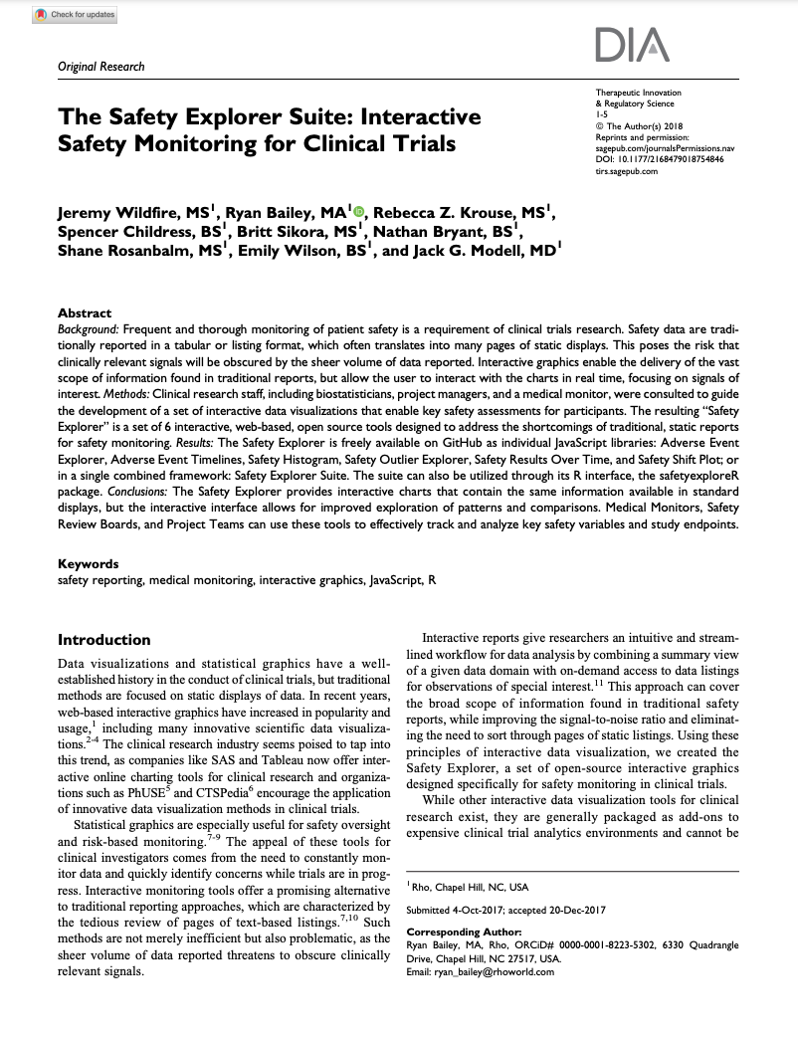
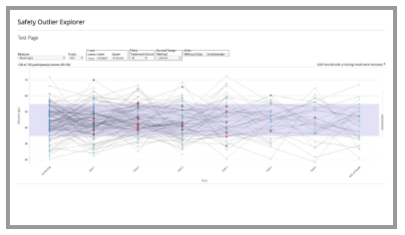
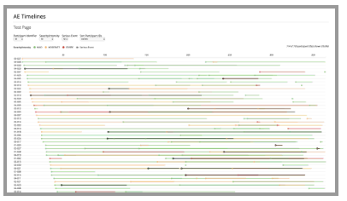
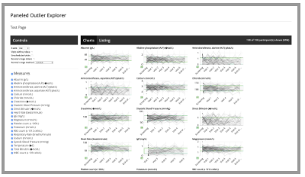
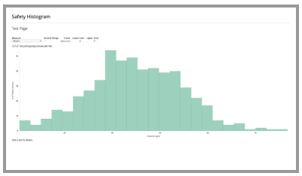
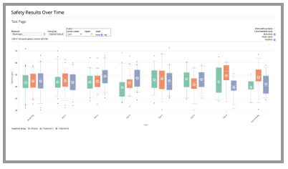
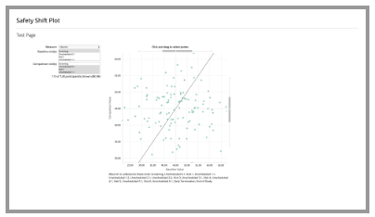
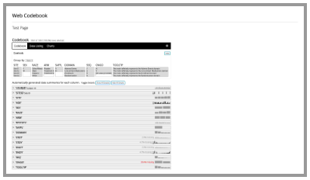
The Safety Explorer Suite: Interactive Safety Monitoring for Clinical Trials, Wildfire et al. 2018
Paper - Repo

Slide 12
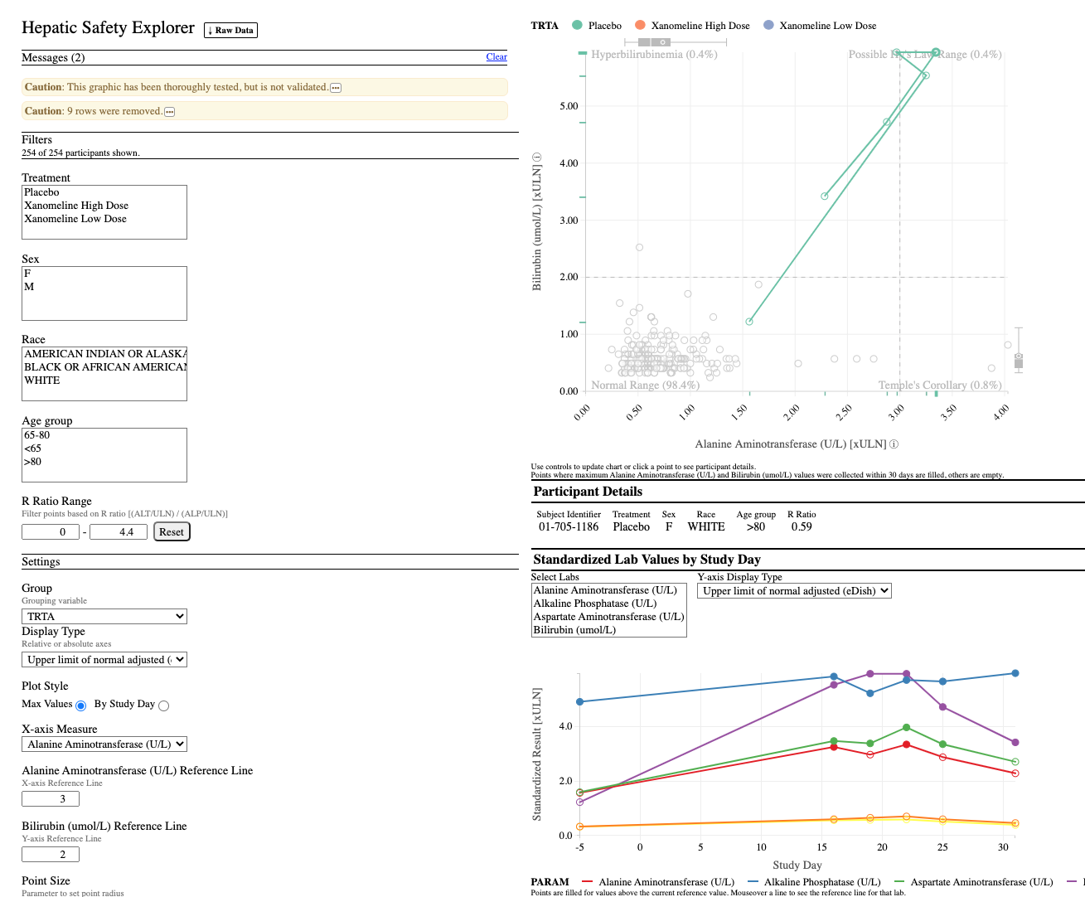
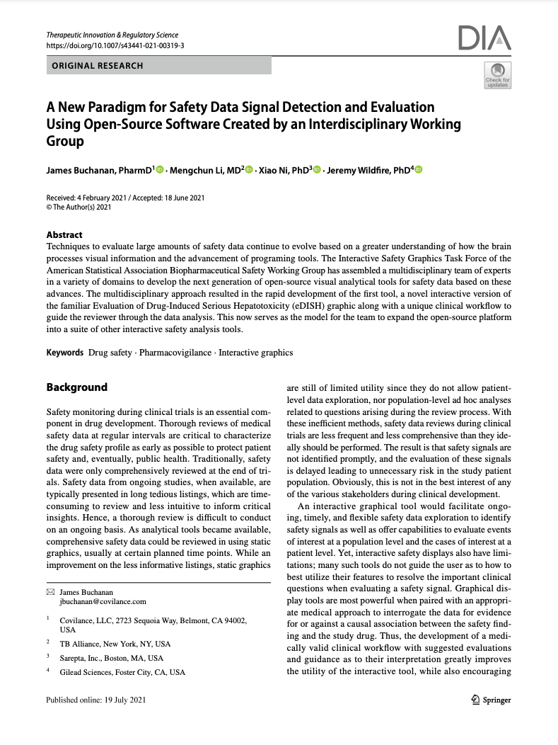
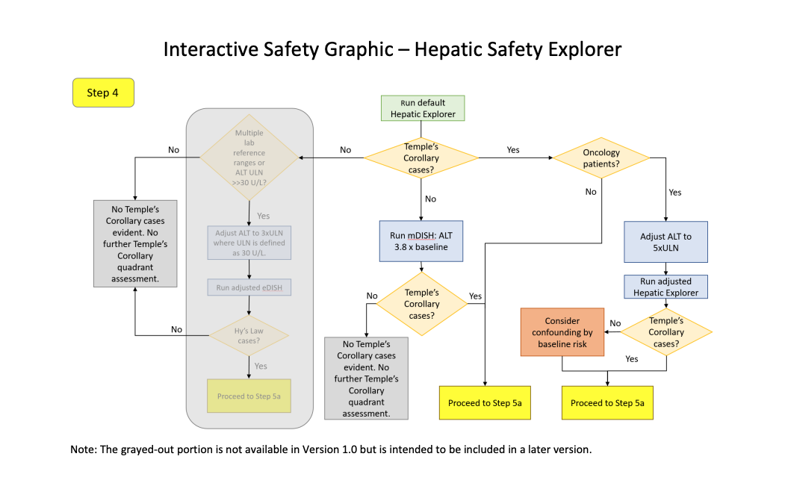
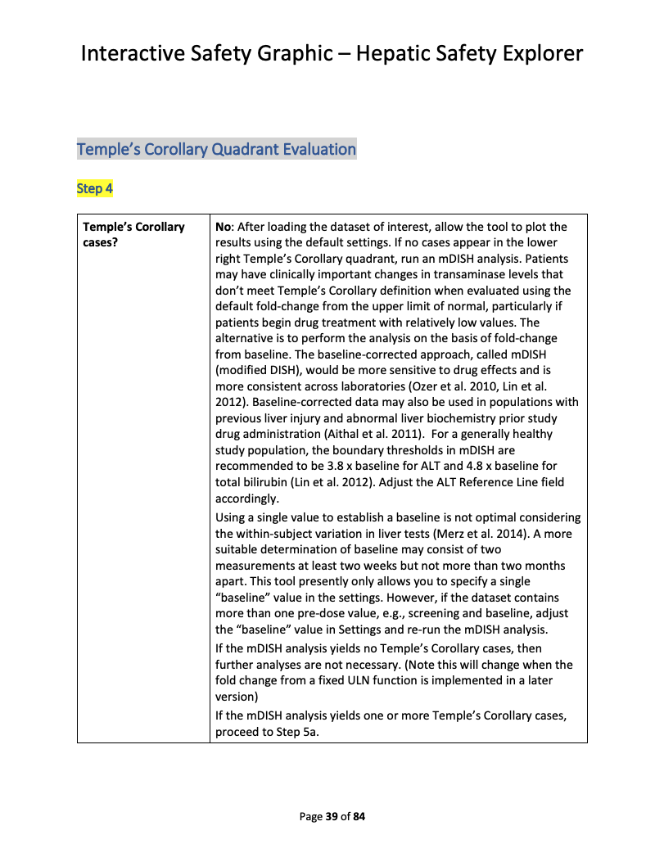
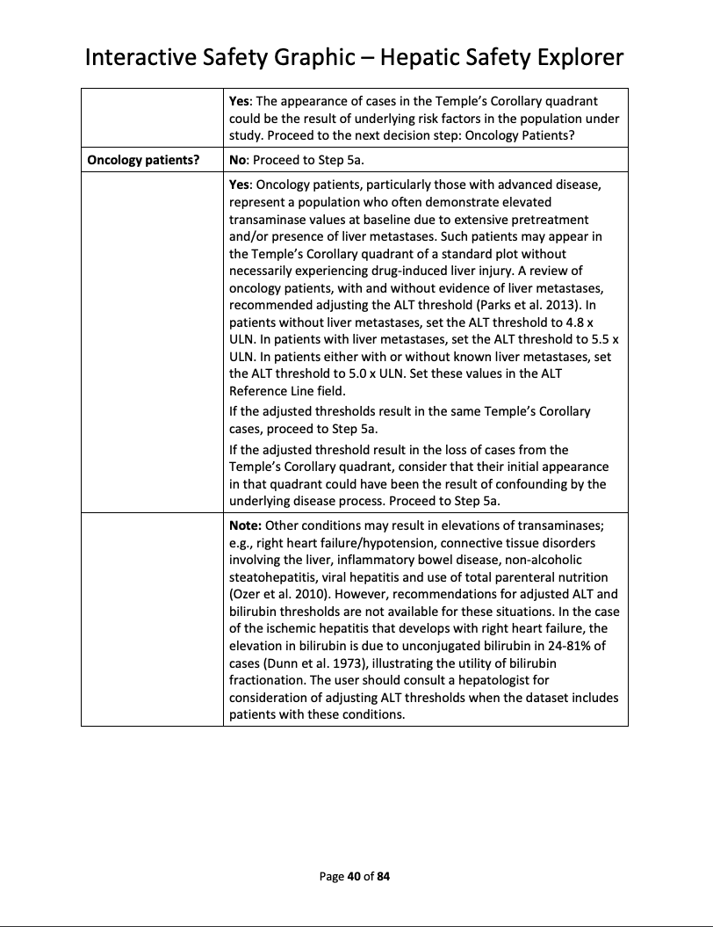
Hepatic Safety Explorer
Demo – Repo – Clinical Workflow – Paper

Slide 13
{safetyGraphics} v1.0 - Lessons Learned
Lab Data only
HTML Widgets only
Adding New Charts
Testing in Shiny
- Saving Customizations
Use R For Data Load/Config
Shared Data and Settings
Flexible data standards
Modular Shiny Framework
Exported HTML Reports
What Worked
Updates Needed

Slide 14




Medical Monitoring
Data Exploration
Data Monitoring Committee
Risk-Based Monitoring?
Notes:
Medical Monitoring
Data Exploration – Supplemental tool for analysts.
Data Monitoring Committee - Novartis submitted graphics to DMC.
Risk-based Monitoring?

Slide 15
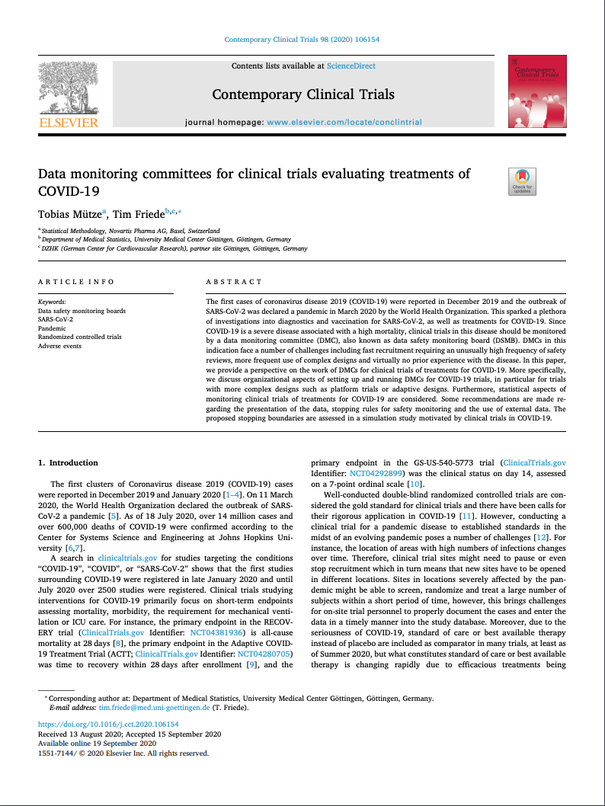
The Safety Explorer Suite: Interactive Safety Monitoring for Clinical Trials, Wildfire et al. 2018
Paper - Repo
A New Paradigm for Safety Signal Detection and Evaluation Using Open-Source Software Created by an Interdisciplinary Working Group. 2021 Buchanan
Paper – Repo
Data Monitoring committees for clinical trials evaluating treatments of COVID-19. Tobias Mütze and Tim Friede. 2020 - Paper

Slide 16
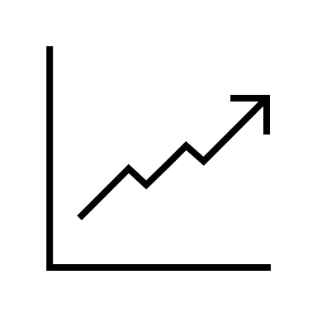

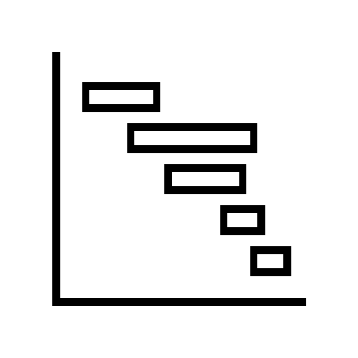
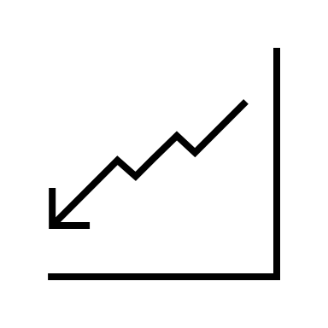



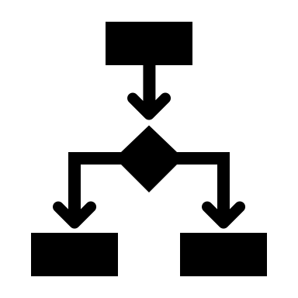



New Charts
Qualification
Deployment
Notes:
More Charts - Expand Chart Coverage to new safety domains
Qualification – Create Qualification Guidelines
Deployment – Run Pilots with interested stakeholders

Slide 17
Vignettes
Intro Vignette - Introductory vignette providing the overview of the package.
Chart Configuration Vignette - Details about the charting process including technical specifications and step-by-step instructions.
Cookbook Vignette - A series of examples showing how to initialize the safetyGraphics Shiny app in different scenarios.
Technical FAQ Vignette - Vignette discussing security, validation and other technical issues.
Link: https://github.com/safetygraphics/safetygraphics/wiki

Slide 18
safetyGraphics Package Ecosystem
The {safetyGraphics} platform displays charts from {safetyCharts}.
{safetyGraphics} – Reusable Shiny App for safety monitoring
{safetyCharts} – Reusable stand-alone charts for safety monitoring
{safetyData} – Sample AdAM and SDTM datasets for examples and testing.

Slide 19
01. Hello World
Run the app with default data, or load data and select charts with a simple GUI
Notes:
1

Slide 20
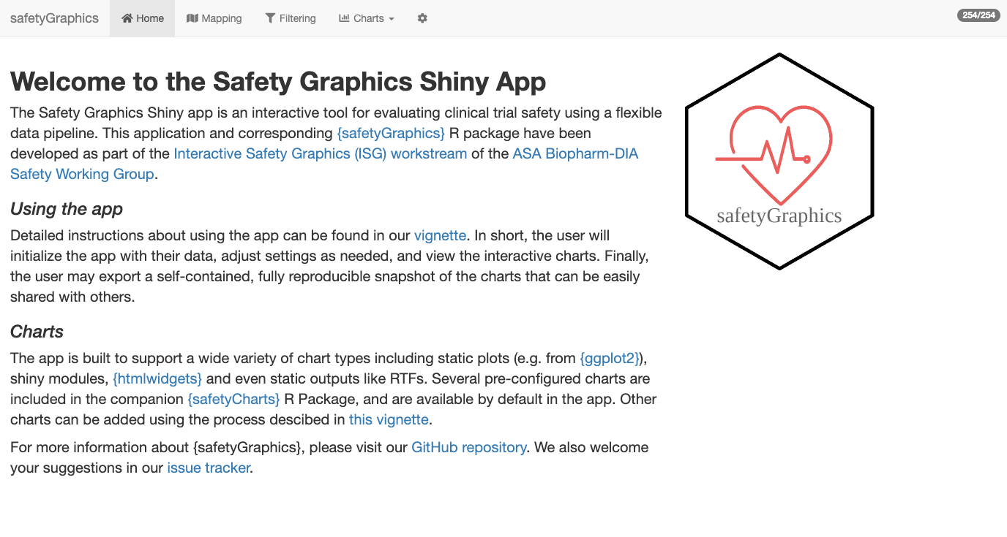
Hello World
01_HelloWorld.R
install.packages('safetyGraphics’)
library(safetyGraphics)
safetyGraphicsApp()

Slide 21
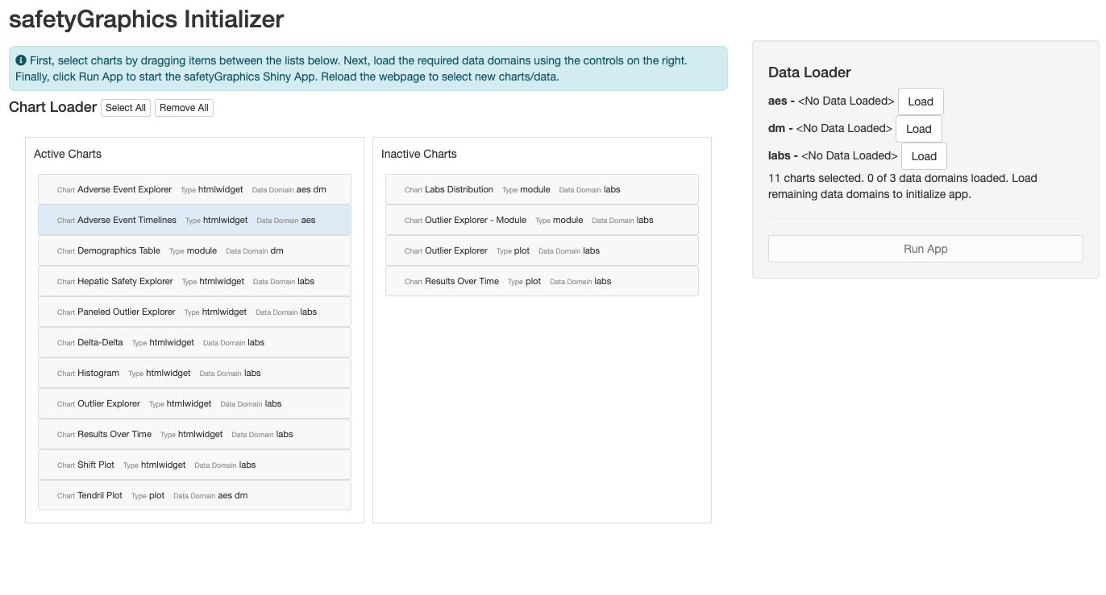
Hello World, Again
01_HelloWorld.R
install.packages('safetyGraphics’)
library(safetyGraphics)
safetyGraphicsInit()

Slide 22
Breakout #1 – Hello World
01_HelloWorld.R
Objectives
Launch the app with `safetyGraphicsApp()`
Familiarize yourself with the basic layout and tab content
Try out the `safetyGraphicsInit()` workflow using sample data

Slide 23
02. Loading Custom Data
Create a reusable R script to load your own data and save a data mapping.

Slide 24
?safetyGraphicsApp docs
safetyGraphicsApp(
domainData = list(
labs = safetyData::adam_adlbc,
aes = safetyData::adam_adae,
dm = safetyData::adam_adsl
),
meta = safetyGraphics::meta,
charts = NULL,
mapping = NULL,
autoMapping = TRUE,
filterDomain = "dm",
chartSettingsPaths = NULL
)
domainData | named list of data.frames to be loaded into the app. Sample AdAM data from the safetyData package used by default
charts | list of charts in the format produced by safetyGraphics::makeChartConfig()
mapping | list specifying the initial mapping values for each data mapping for each domain (e.g. list(aes= list(id_col='USUBJID', seq_col='AESEQ')).
autoMapping | boolean indicating whether the app should attempt to automatically detect data standards and generate mappings for the data provided. Values specified in the mapping parameter overwrite automatically generated mappings when both are found. Defaults to true.
meta | data frame containing the metadata for use in the app. See the preloaded file (?safetyGraphics::meta) for more data specifications and details. Defaults to safetyGraphics::meta.
filterDomain | domain used for the data/filter tab. Demographics ("dm") is used by default. Using a domain that is not one record per participant is not recommended.
chartSettingsPaths | path(s) where customization functions are saved relative to your working directory. All charts can have initialization (e.g. myChart_Init.R) and static charts can have charting functions (e.g. myGraphic_Chart.R). All R files in this folder are sourced and files with the correct naming convention are linked to the chart. See the Custom Charts vignette for more details.

Slide 25
safetyGraphicsApp() – Configurable Inputs
Study-Specific Inputs
domainData – Domain-level Study Data
mapping – List identifying the key columns/fields in your data
General Inputs used across multiple studies
charts – Define the charts used in the app.
meta – Metadata table with info about required columns and fields

Slide 26





Domain Data
Interactive Graphics
Charts
Metadata + Mapping

Slide 27
safetyGraphicsApp() Inputs – domainData
domainData
mapping
charts
meta
Pass study data to the app with the `domainData` parameter
domainData is a named list of `data.frame` or `tibble` objects.
Each item in the list stores data for a single data domain.
AdAM data from {safetyData} for 3 domains (labs, aes, dm) is used by default:
Additional domains can be added using `meta` (see section 5 in this workshop)
# domainData default
list(
labs = safetyData::adam_adlbc,
aes = safetyData::adam_adae,
dm = safetyData::adam_adsl
)

Slide 28
Examples 2.1 / 2.2 / 2.3
02_CustomData.R
Objective - Gain experience initializing the app with different data types
Example 2.1 – Initialize app with SDTM data (instead of ADaM)
Example 2.2 – Load a single data domain
Example 2.3 – Load a SAS Transport data set

Slide 29
safetyGraphicsApp() Inputs – mapping
domainData
mapping
charts
meta
Specify Columns and Fields in your data with the `mapping` parameter
`mapping` is a list that pre-specifies column and field names found in `domainData`.
Users must provide mappings, or generate one in the app. (There is no default).
Here is an example of a simple custom mapping:
`mappings` can be viewed and adjusted on the mapping tab, and can be exported from the settings tab.
The app generates an “automapping” using common data standards, but …
… the `mapping` parameter takes precedence over “automapping”. (see `?detectStandard` for more)
Details about mappings are stored in the `meta` parameter. See Section 5 of this workshop for details.
# sample mapping
list(
aes= list(id_col='USUBJID', seq_col='AESEQ')
labs= list(measure_col = 'customMeasureCol')
)

Slide 30
Example 2.4
02_CustomData.R
Objective - Gain experience with custom data mappings
Example 2.4 – Make a slight modification to our default data, and then account for the change using a custom mapping.

Slide 31
Breakout #2 – Custom Data + Mapping
02_Excercise.R
Objectives
Load non-standard data in the app
Create a custom mapping to simplify app configuration

Slide 32
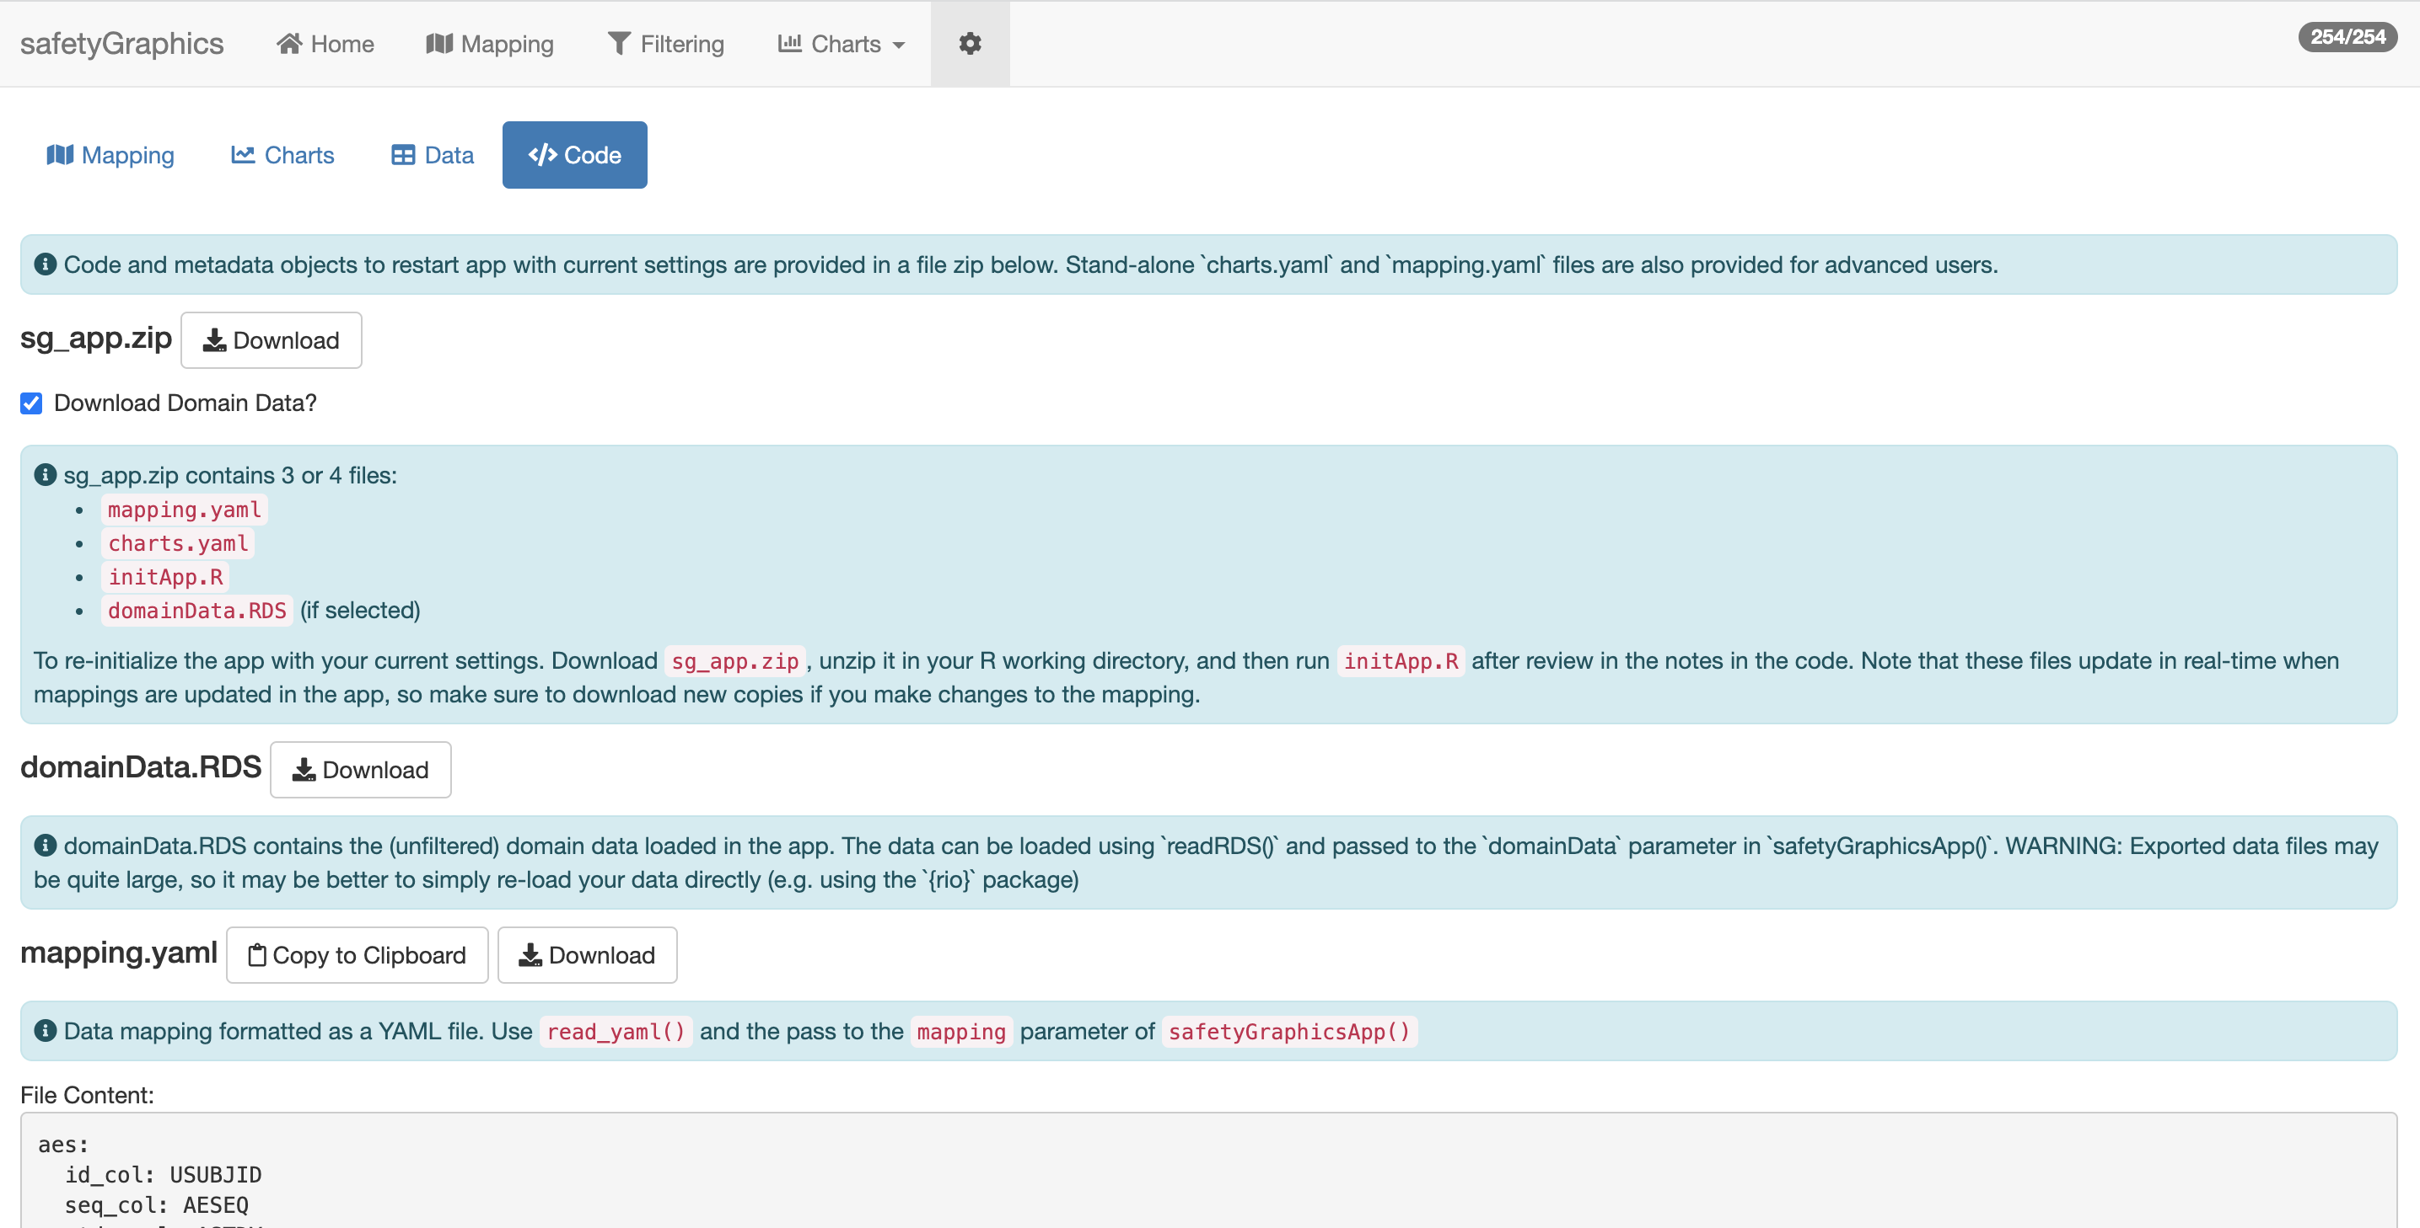
App Export
https://github.com/SafetyGraphics/safetyGraphics/wiki/ChartConfiguration

Slide 33
03. App/Chart Export
Export Code to reproduce the whole app or individual charts

Slide 34
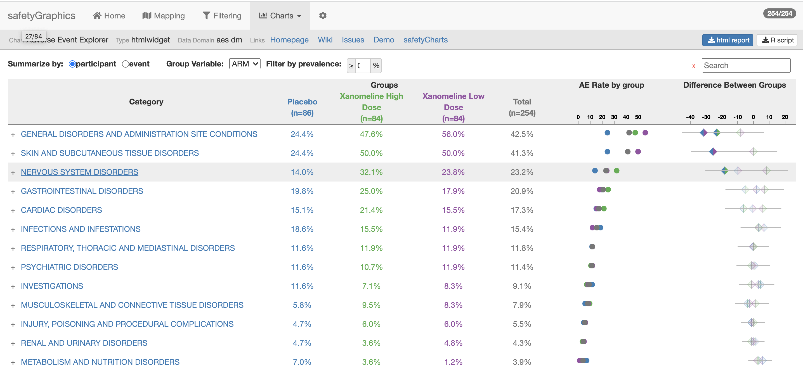
Chart Export

Slide 35
Optional Exercise
03_Excercise.R
Objective
Export a chart
Manually customizing chart code after export
Notes:
\

Slide 36
04. Customizing Charts
Select from existing charts in the safetyCharts package or add your own!
Notes:
3

Slide 37
safetyGraphicsApp() Inputs – charts
domainData
mapping
charts
meta
Define charts in the app with the `charts` parameter
`charts` is a complex list that defines which charts are used in the app.
Charts defined in the `safetyCharts` package are included by default (see ?makeChartConfig)
Many types of chart are supported including htmlwidgets, shiny modules and static charts and tables.
Users can create custom charts by defining a `config` object and a `chart` function.
The Custom Chart vignette describes the chart workflow in detail.

Slide 38
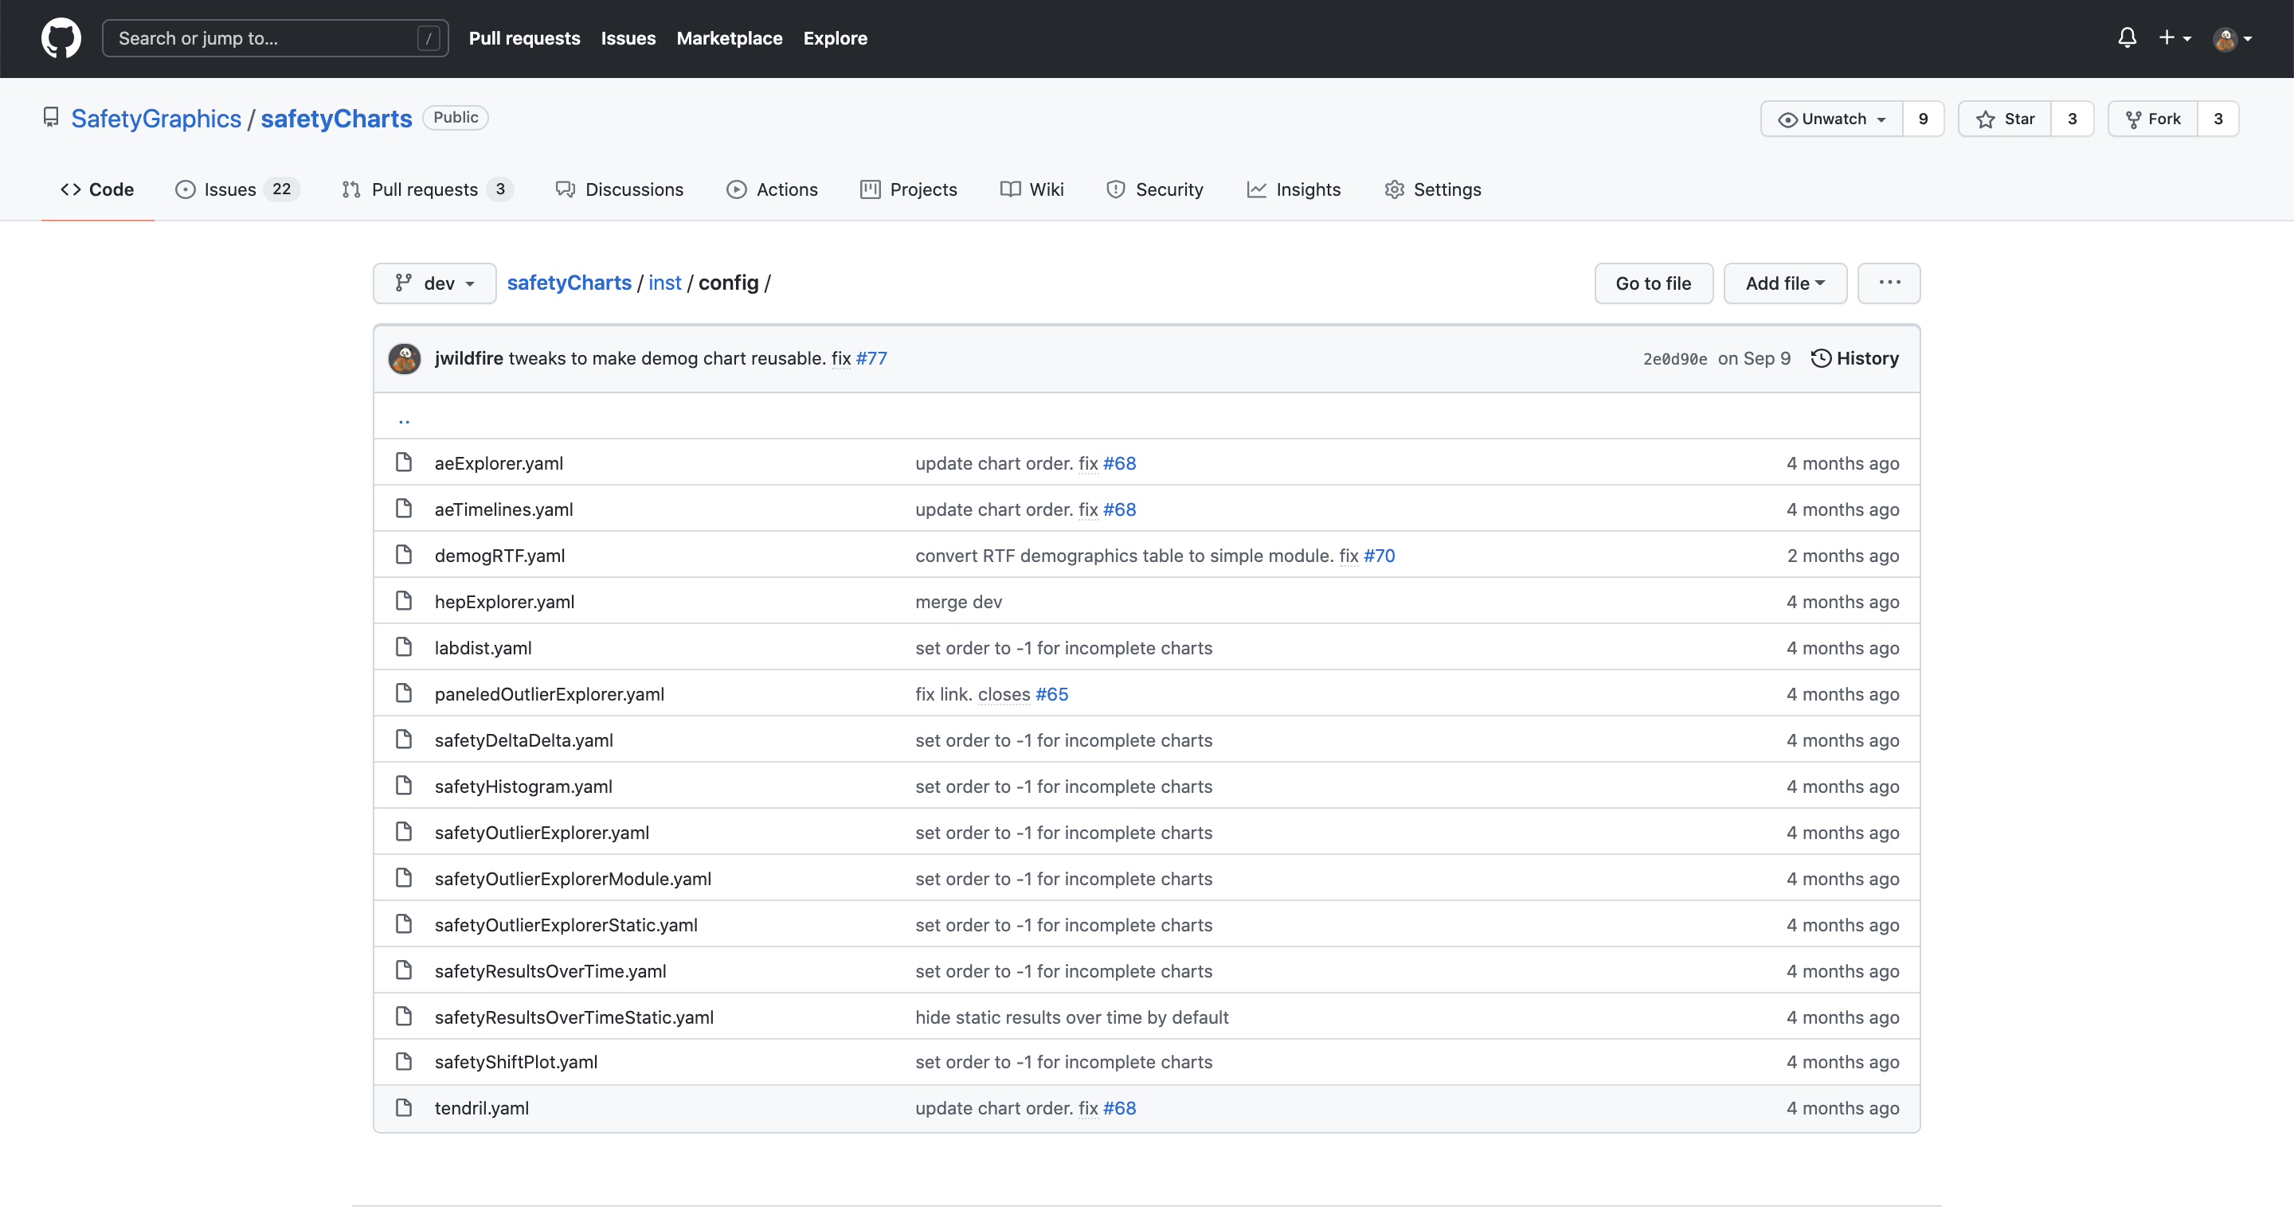
Default Charts from safetyCharts

Slide 39
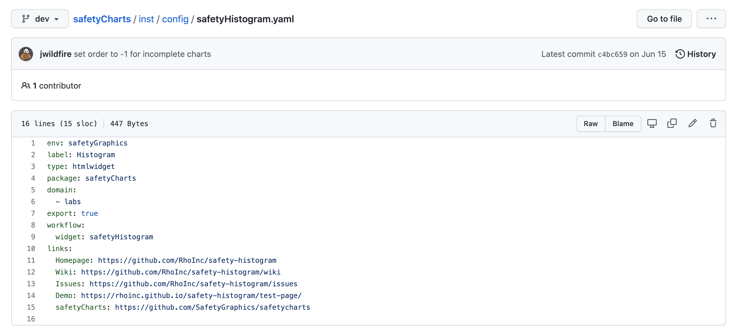
Default Charts from safetyCharts

Slide 40
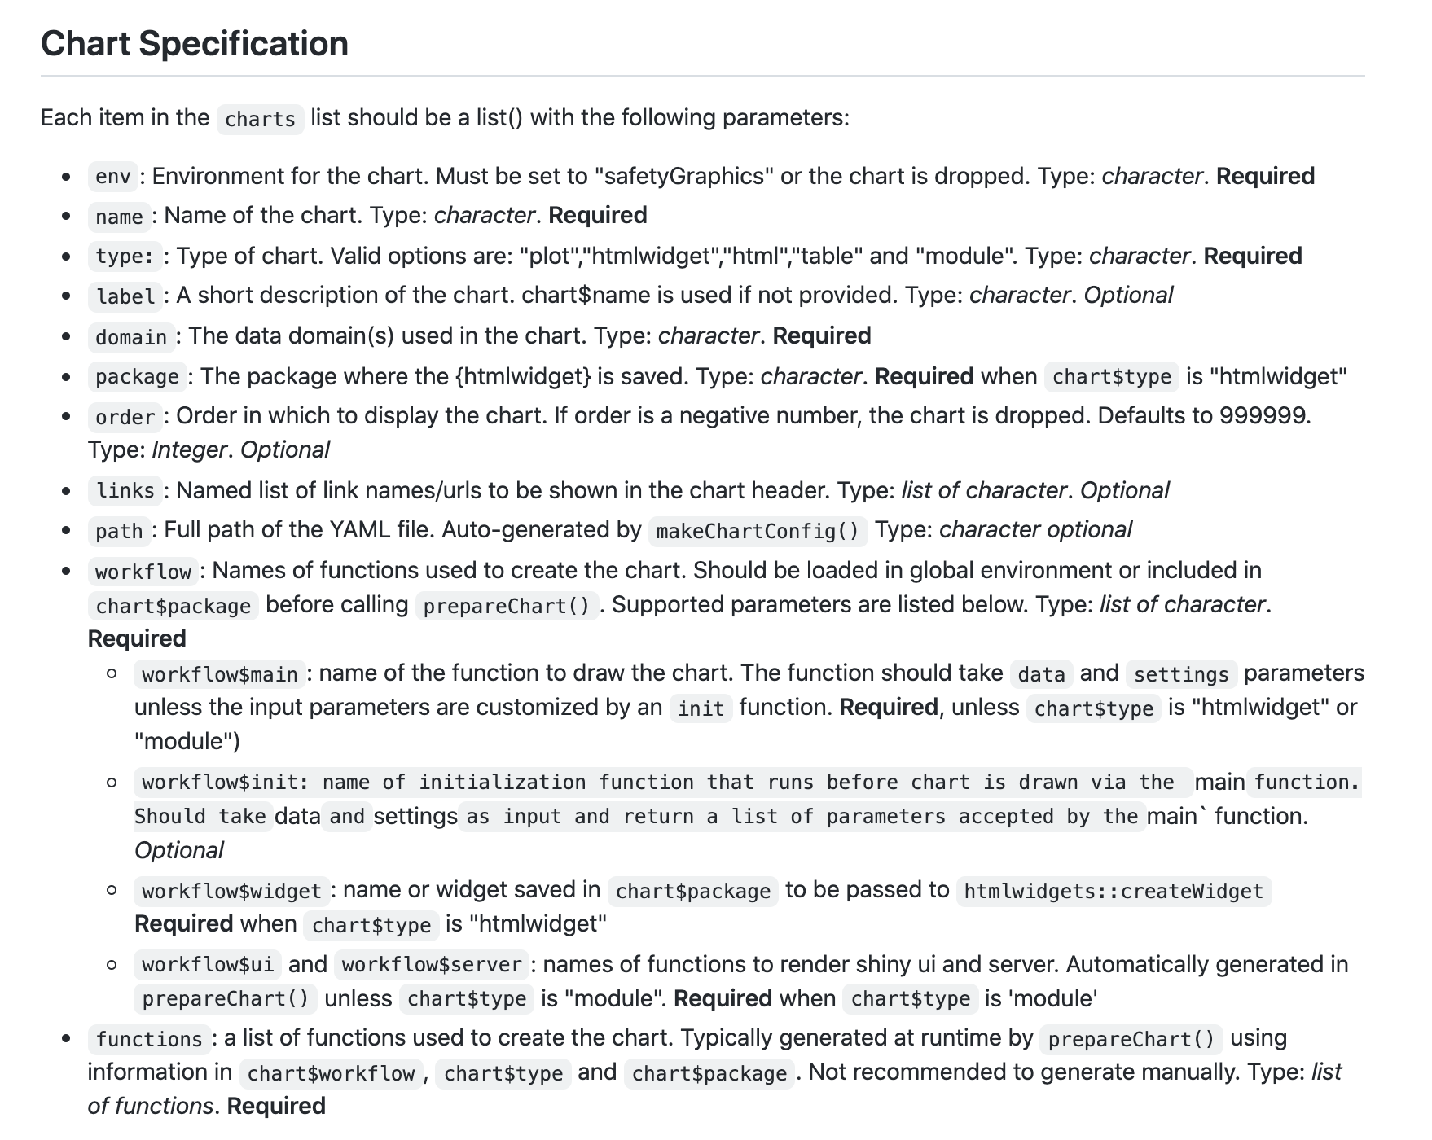
Link to wiki

Slide 41
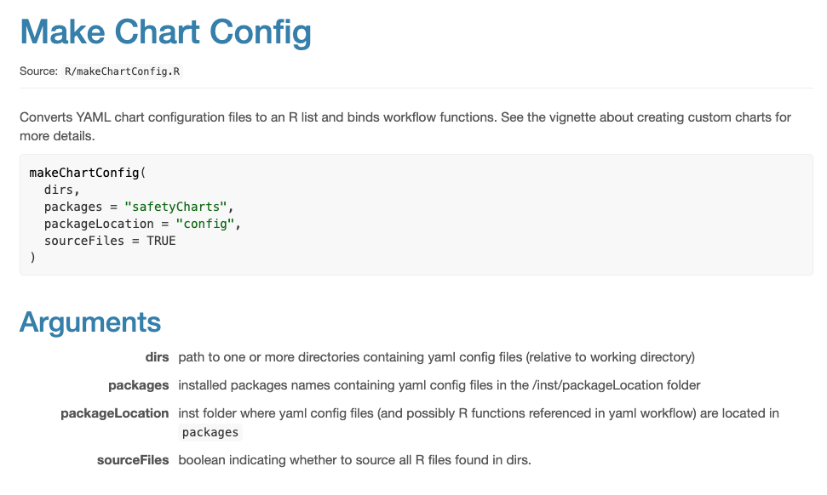
?makeChartConfig

Slide 42
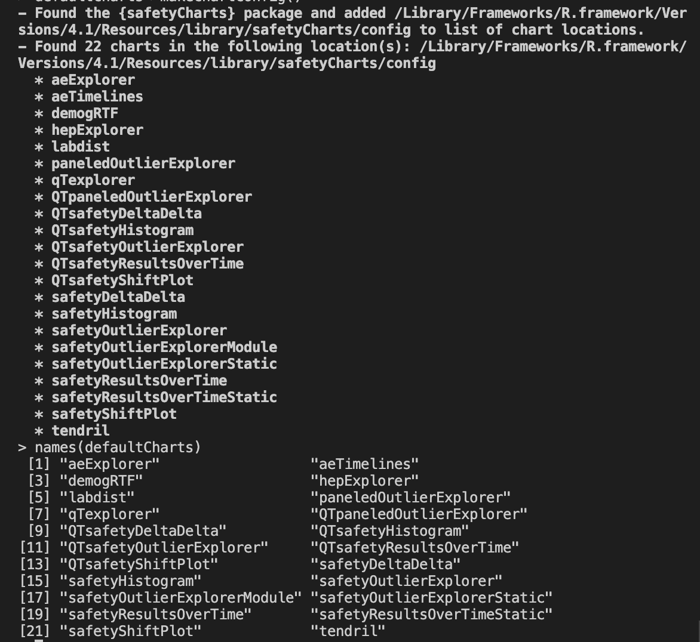
> # load charts from safetyCharts
> defaultCharts <- safetyGraphics::makeChartConfig()

Slide 43
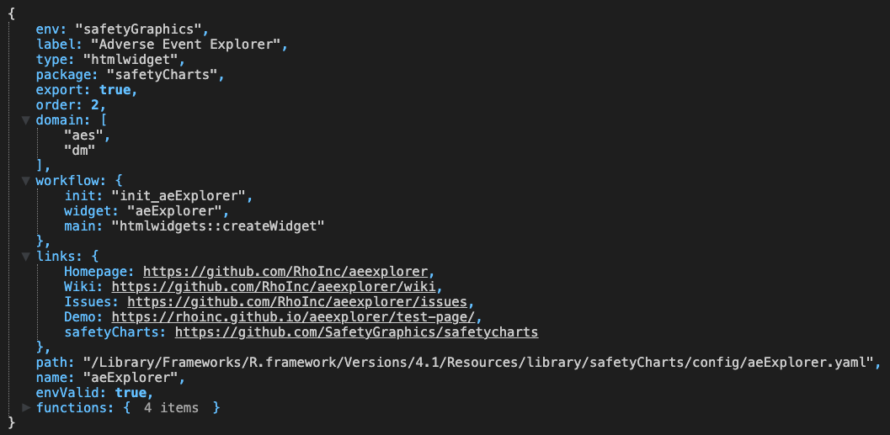
> # load charts from safetyCharts
> defaultCharts <- safetyGraphics::makeChartConfig()
> View(defaultCharts[[1]])

Slide 44
Examples 4.1 / 4.2
04_CustomCharts.R
Objective – Customize the default charts from safetyCharts
Example 4.1 – Drop unwanted charts
Example 4.2 – Edit metadata for a default chart

Slide 45
Breakout #3 – Update Default Charts
04_Excercise1.R
Objectives
Practice configuring default charts

Slide 46
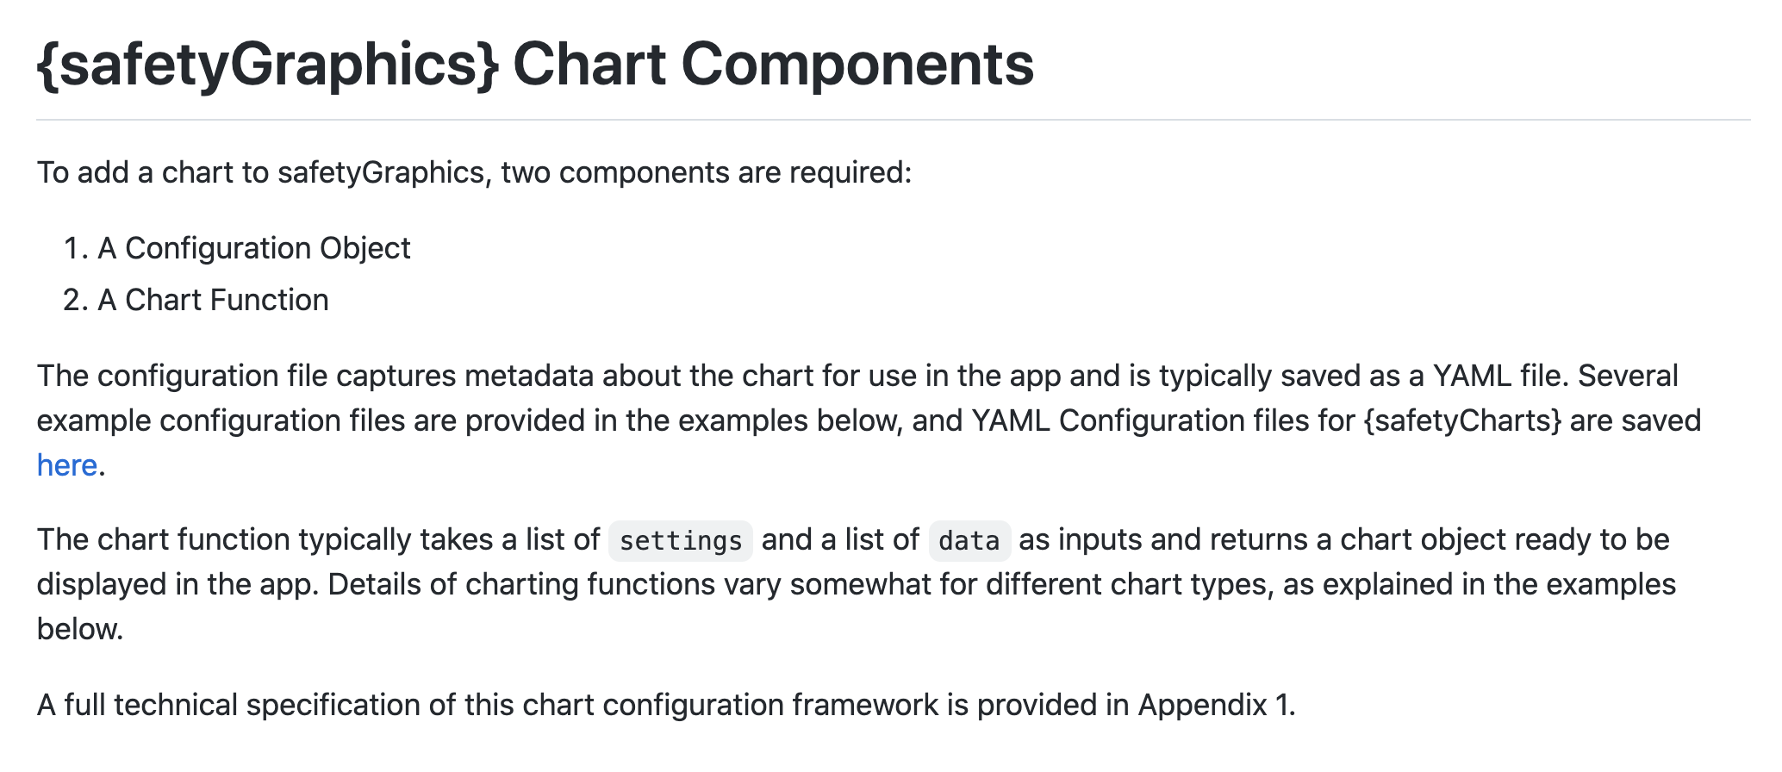
Adding Charts - Custom Chart Vignette
https://github.com/SafetyGraphics/safetyGraphics/wiki/ChartConfiguration

Slide 47
Link to wiki

Slide 48
Example 4.3 - Hello World
04_CustomCharts.R
Chart Function
Chart config
helloWorld <- function(data, settings){
plot(-1:1, -1:1)
text(
runif(20, -1,1),
runif(20, -1,1),
"Hello World”
)
}
helloworld_chart<-list(
env="safetyGraphics",
name="HelloWorld",
label="Hello World!",
type="plot",
domain="aes",
workflow=list(
main="helloWorld"
)
)
Run App
> safetyGraphicsApp(charts=list(helloworld_chart))

Slide 49
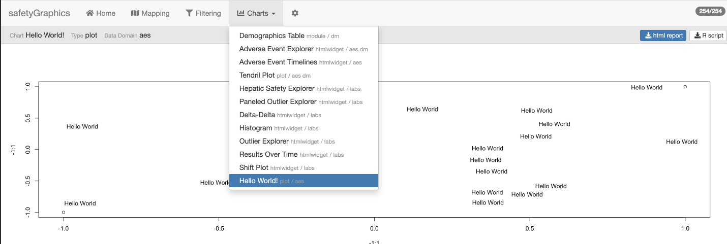

Slide 50
Reusable Chart Functions & the Tidyverse
Many tidyverse packages (including dplyr and ggplot2) require some modification when used in functions. To make a long story short:
We recommend using the .data[[]] pronoun in safetyGraphics chart functions.
col_summary <- function(df, col) {
ggplot(df) +
geom_bar(aes(x = .data[[col]])) +
coord_flip()
}
col_summary(mpg, "drv")
mpg_drv_summary <- function() {
ggplot(ggplot2::mpg) +
geom_bar(aes(x = drv)) +
coord_flip()
}
For more details see: Using ggplot2 in packages , Programming with dplyr and the functional programming chapters in Advanced R

Slide 51
Examples 4.3 / 4.4 / 4.5
04_CustomCharts.R
Objective – Add custom charts to safetyGraphics
Example 4.3 – Hello World Chart
Example 4.4 – Simple custom demographics histogram
Example 4.5 – Lab Outlier Explorer - Static
Example 4.6 (optional) – Lab Outlier Explorer – Shiny Module

Slide 52
Breakout #4 – Custom Chart Creation
04_Excercise2.R
Objectives
Adapt a static chart for use in safetyGraphics

Slide 53
Shiny App
# Start safetyGraphics Shiny App with custom charts
safetyGraphicsApp(charts=myCharts)
myCharts list()
# Make list of all charts in specific location
# Specify ‘path’ or ‘package’ - ‘safetyCharts’ = default
myCharts<-makeChartConfig()
aeExplorer
list(…)
outlierModule
list(…)
…
newChart
list(…)
myCharts$newChart list()
name
‘newChart’
domain
‘labs’
type
‘htmlwidget’
# Add a Single Chart (usually saved as yaml)
# Automatically called for yaml in ‘path’/‘package’
myCharts$newChart<-read_yaml(path)
workflow
list(…)
functions
list(…)
myCharts$newChart$functions list()
# Bind list of functions to a chart
# Specified by chart$workflow, chart$type & chart$package
# Automatically called for yaml in ‘path’/‘package’
myCharts$newChart<-prepareChart(myCharts$newChart)
ui
function()
server
function()
init
function()
main
function(data, settings)
data
list(df1,df2,…)
settings
list(list1,list2,…)
# Data and Setting inputs used in main() and init()
# reactive() in shiny app, but not in exported code.

Slide 54
05. Adding Custom Domains
Customize `meta` to add data domains to the app, and then create charts using the data!

Slide 55
safetyGraphicsApp() Inputs – meta
domainData
mapping
charts
meta
Customize charts and data configuration with `meta` parameter
`meta` is a dataframe that defines the columns and fields used in safetyGraphics charts
A default set of metadata for Adverse events (‘aes’), lab results (‘labs’) and demographics (‘dm’) is included as `safetyGraphics::meta`
Determines which data domains are included in the app.
Populates mapping tab in shiny app.
`labs`, `dm` and `aes` domains included by default
New domains are added when found in `meta`

Slide 56
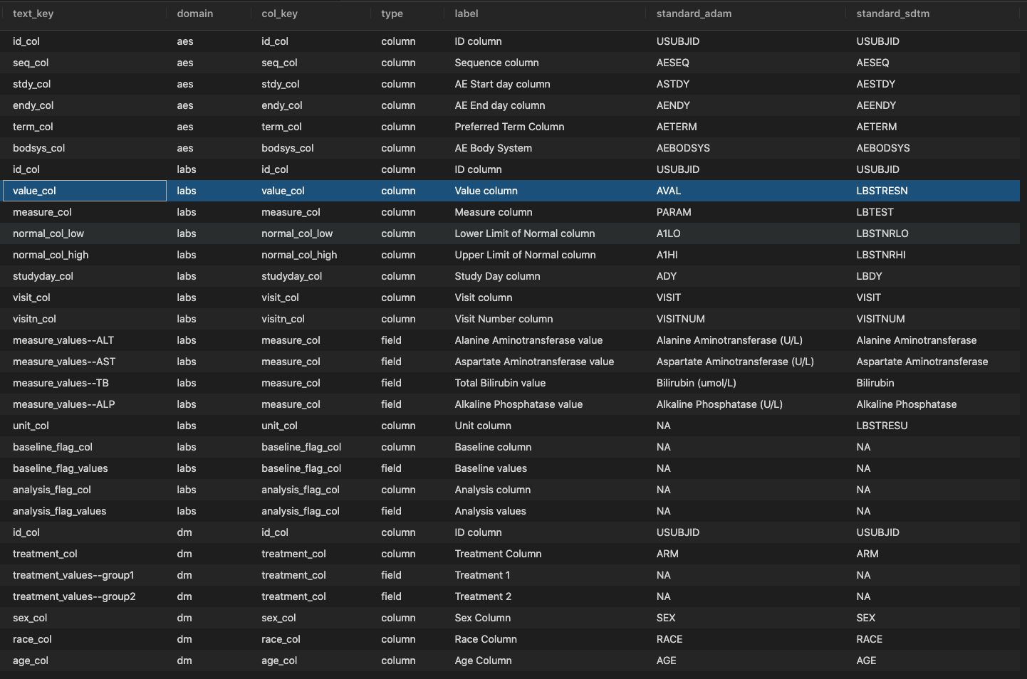
> # view default metadata
> View(safetyGraphics::meta)

Slide 57
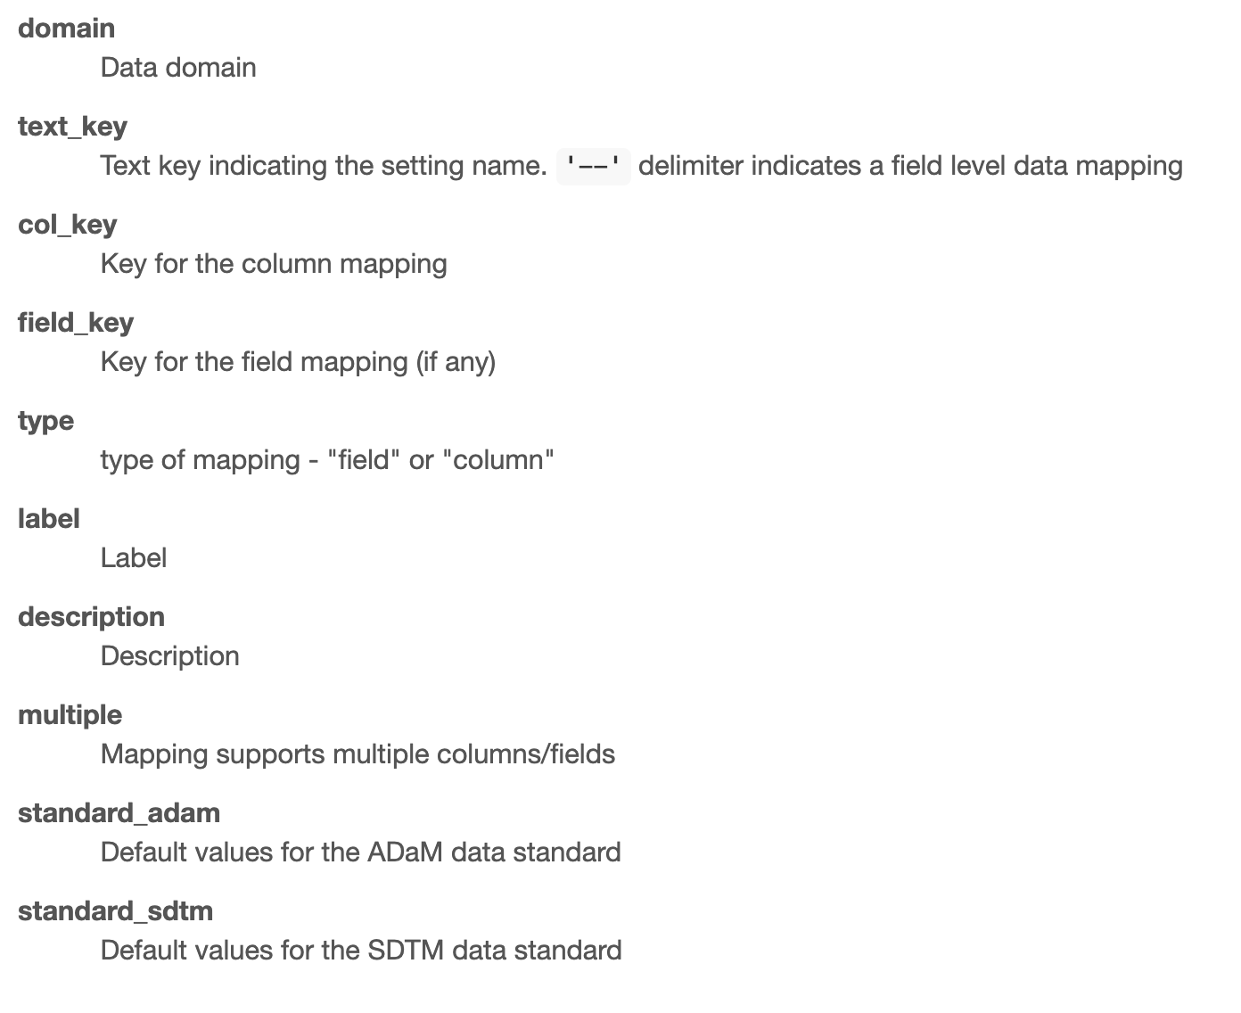
?safetyGraphics::meta Metadata Column Definitions

Slide 58
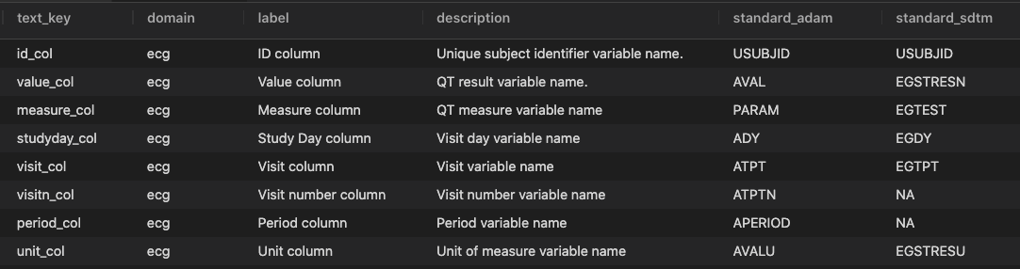
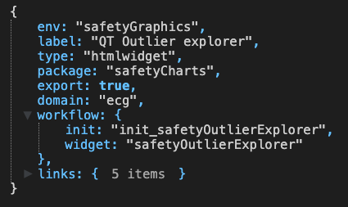
Creating a Chart in a Custom Domain
safetyGraphicsApp(
meta=ecg_meta,
charts=ecg_chart,
domainData=list(ecg=adeg)
)
1
Create metadata for new domain
1
2
3
2
Define a chart using the new domain
3
Load data for the new domain
adeg <- readr::read_csv("https://physionet.org/files/ecgcipa/1.0.0/adeg.csv?download")

Slide 59
Examples 5.1 / 5.2 / 5.3
05_CustomDomain.R
Objective - Gain experience using the `meta` parameter for `safetyGraphicsApp()` to create custom data domains
Example 5.1 – Create a vitals domains using labs as a template
Example 5.2 – Create a hello world domain from scratch
Example 5.3 – Create an ecg domains with custom charts

Slide 60
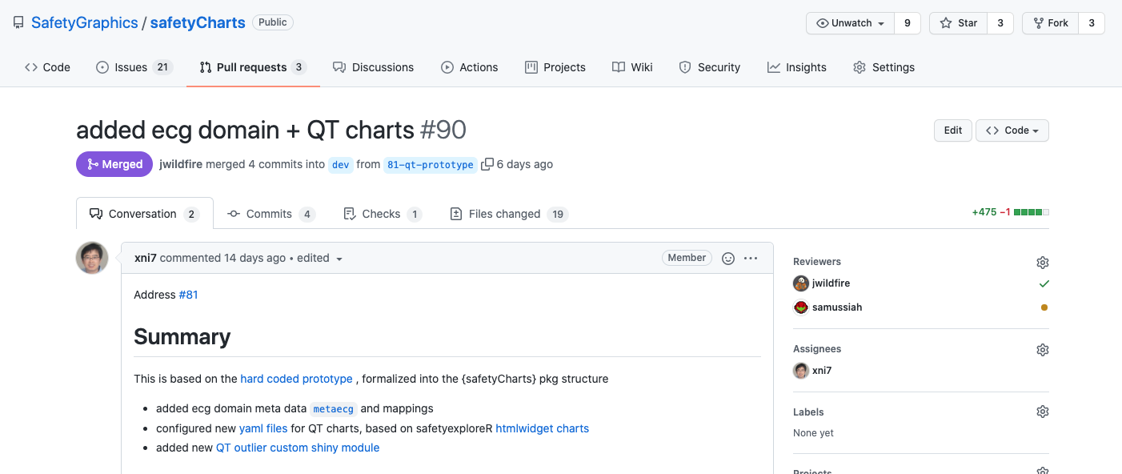
Full implementation of custom ECG domain
https://github.com/SafetyGraphics/safetyCharts/pull/90

Slide 61
Want to get involved? Comments on the Workshop? Ideas for New Charts?
Fill out this form!
(or send us an email)

Slide 62
Appendix – Shiny Modules Demo

Slide 63
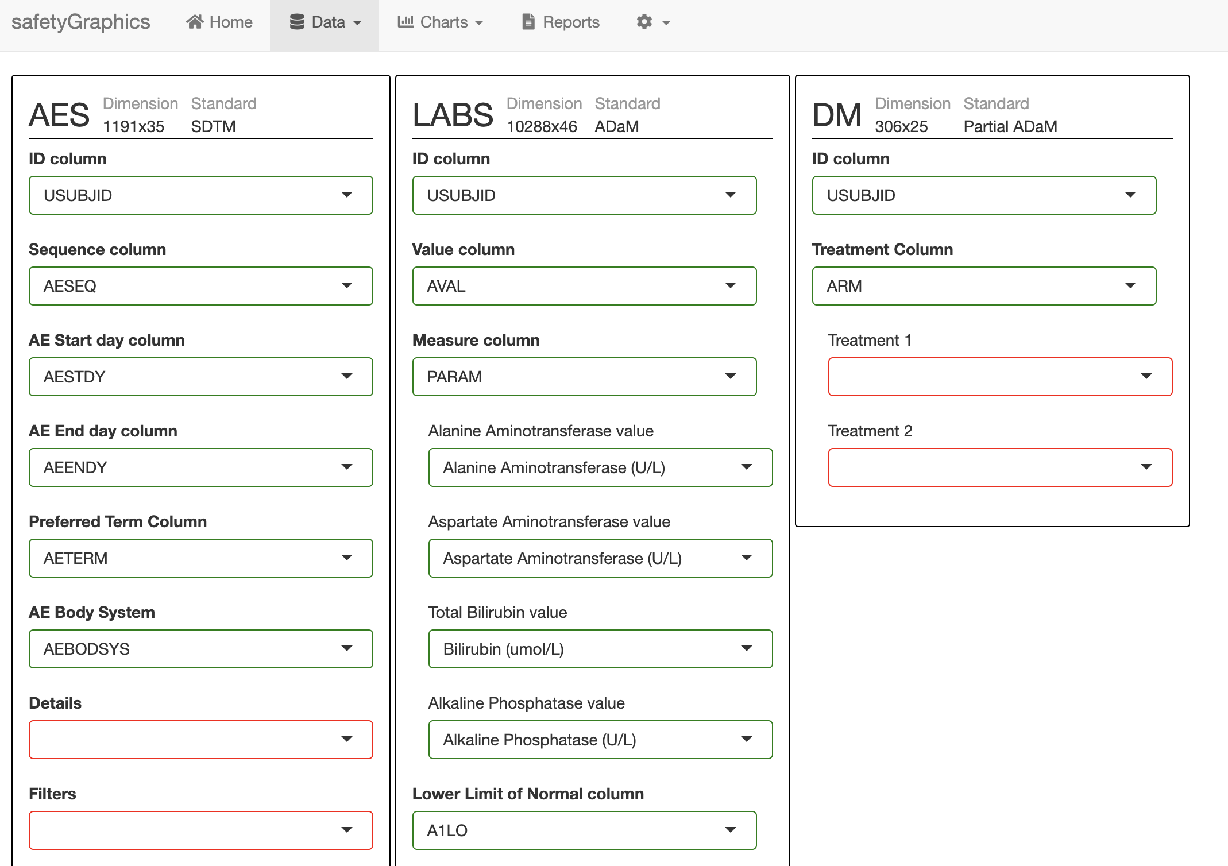
safetyGraphics 2.0 Multiple Data Domains
1 Mapping Tab Module

Slide 64
safetyGraphics 2.0 Multiple Data Domains
3 Domain Modules

Slide 65
safetyGraphics 2.0 Multiple Data Domains
14 Column Modules

Slide 66
safetyGraphics 2.0 Multiple Data Domains
20 Select Modules

